Slide 1

By Uk Anthony and Mimo Adenuga
MIT 5702 Social Network Analytics
03/08/2018

Slide 2
Analyses
NodeXL Analysis
Conversation groups by
Connected components
Language
Time zone
Sentiment - LIWC
Official account edges
R Analysis
Syuzhet Analysis
Wordcloud – frequent words (including word pairs)
Word correlation
Topic Modelling via cluster analysis
Topic Modelling via LDA

Slide 3


Official Accounts
Official accounts
@theblackpanther
@disney
@waltdisneyco
@marvel
@marvelstudios
Edges related to official accounts are in red in network graphs

Slide 4
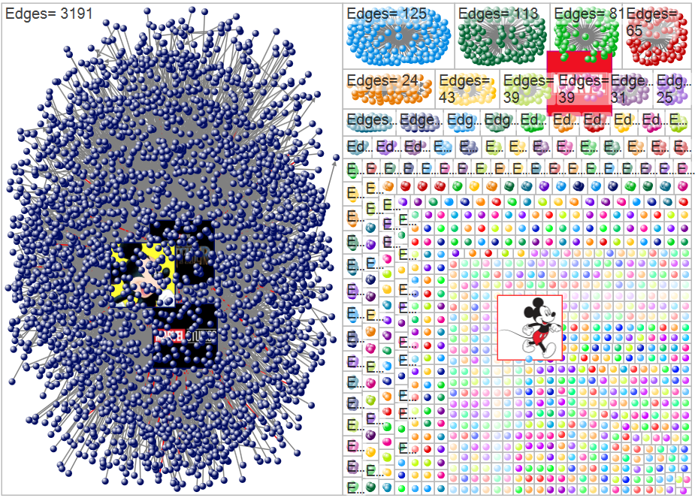
Official Accounts Were Part of Biggest Conversation
791 connected component groups
0.645 modularity
Most active group had 3,191 unique edges (entire data: 5,741)
@theblackpanther, @disney and @marvelstudios were involved in the most active conversation group
With a top-7 betweenness centrality value, @theblackpanther is a bridge between many accounts

Slide 5
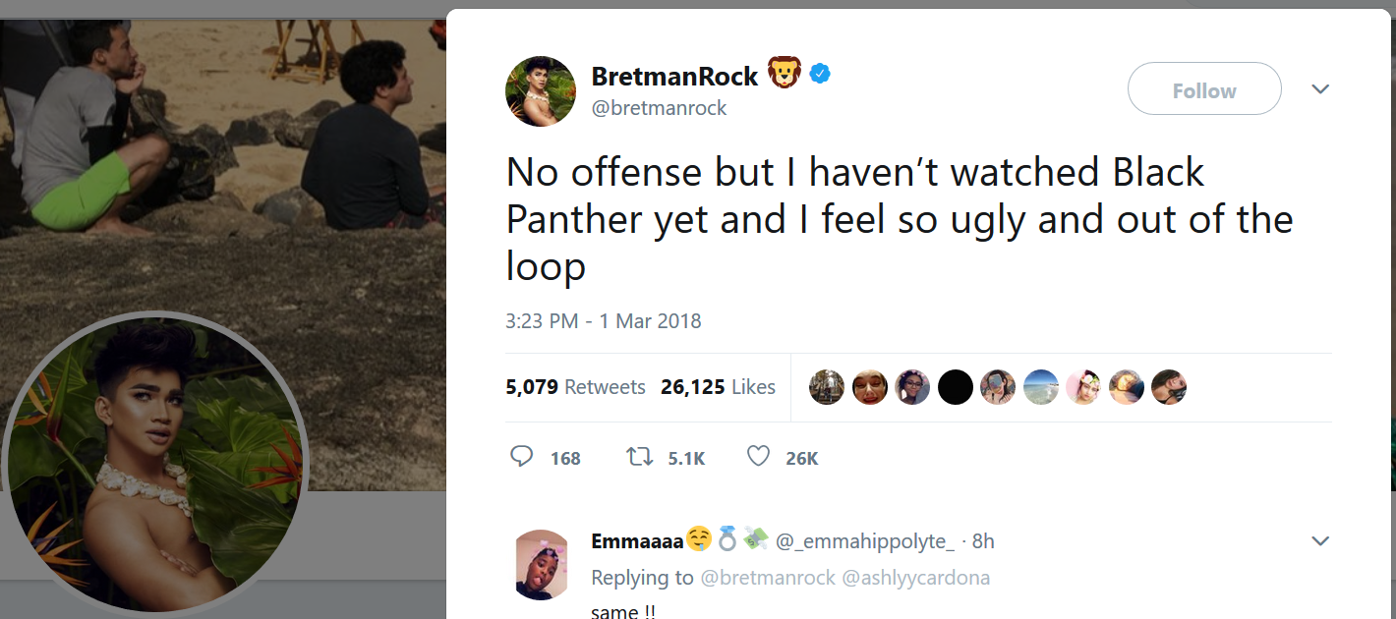
Highest In-Degree Centrality
@bretmanrock: internet celebrity
Tweet represents 7% of our data

Slide 6
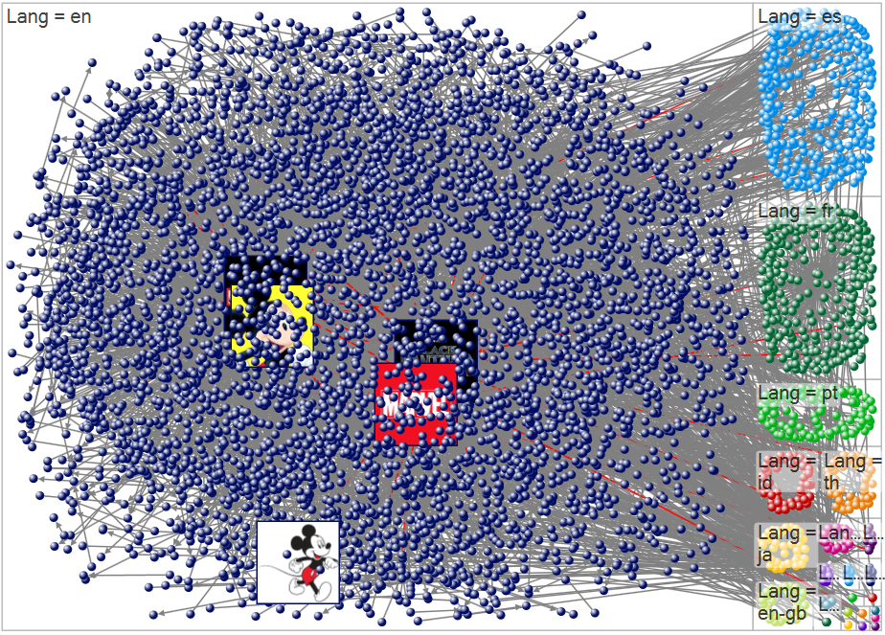
Language
There was nothing really surprising about our language analysis
A majority of the tweets were in English
Languages closing out the top three were Spanish and French

Slide 7
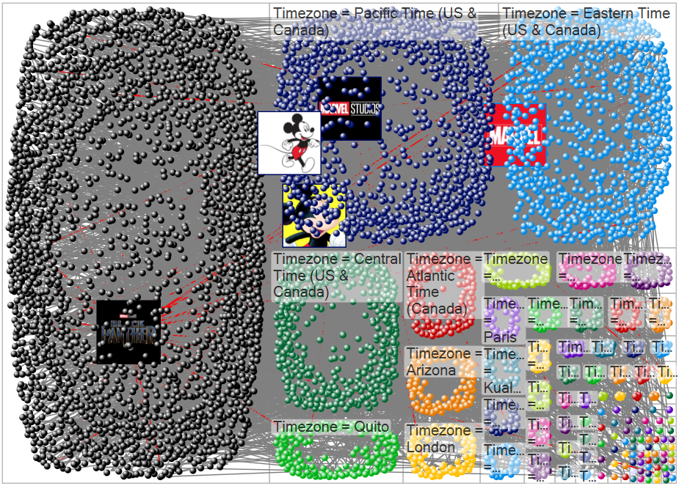
Time zone
Nodes from both coasts dominated the conversation on Twitter
Majority of the users did not have timezones
The most active non-US time zone was London

Slide 8
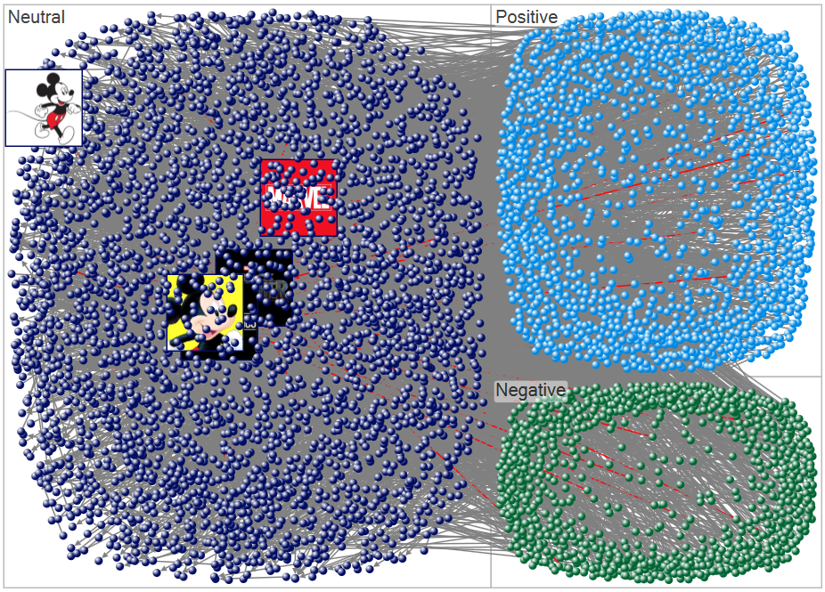
Overall Sentiment
The dominant sentiment was neutral
The official corporate accounts were in this neutral group
Majority of users we found in the positive group were social media influencers

Slide 9
Drive Analysis
Used LIWC to analyze the conversations of race, equality, role models and hope associated with Black Panther
LIWC
Drives
Affiliation
Achievement
Power
Reward
Risk
Drives*
>0: Positive Drive
=0: Neutral Drive

Slide 10
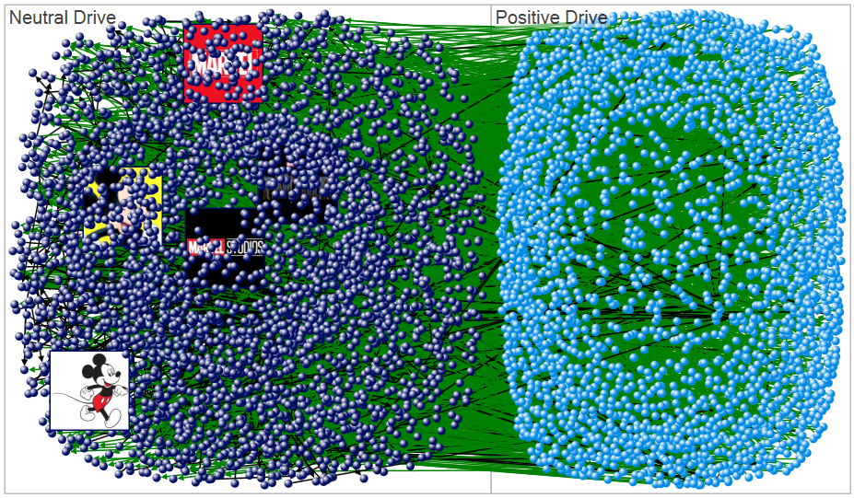
Drive Analysis
Most accounts were neutral on average
Official accounts were neutral on average
Green Edges = Positive Drive
Black Edges = Neutral Drive

Slide 11
Drive Analysis
Although most accounts were neutral on average, most of the conversations had a positive drive

Slide 12
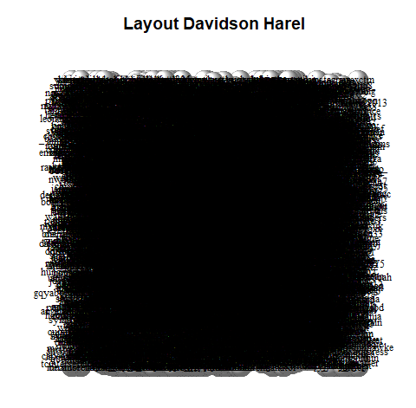
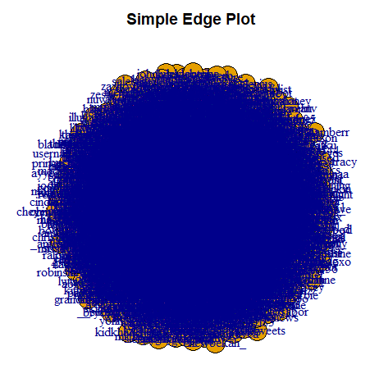
R Network Graphs
Too much data to infer anything meaningful
Graphs took too long to execute

Slide 13
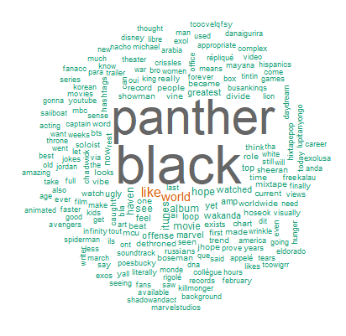
Word cloud based on word frequency
The words “Black” and “Panther” were obviously our most frequently occurring words
They also skewed the word cloud

Slide 14
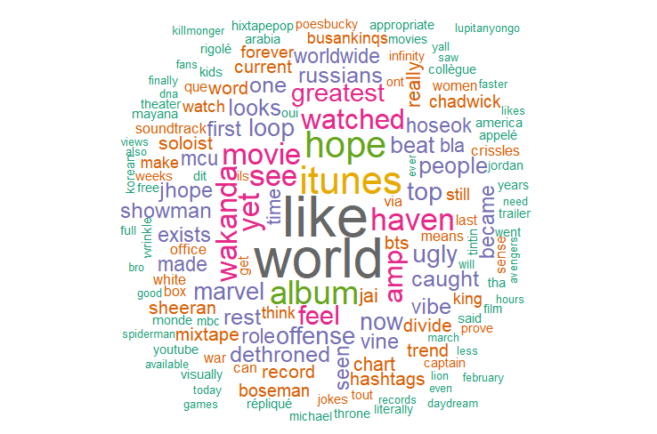
Filtered Word Cloud
A better representation of the word frequency
“Like” and “world” immediately standing out because of the filter

Slide 15
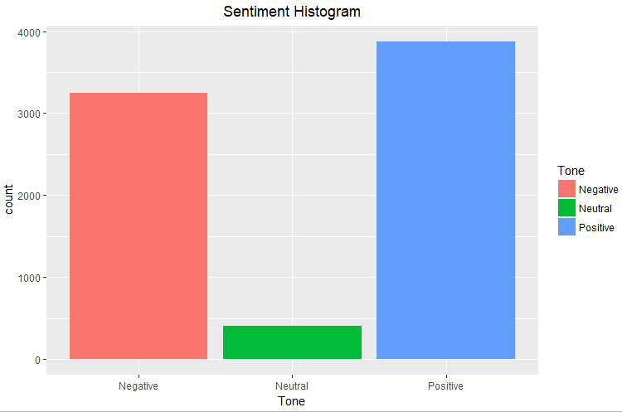
Syuzhet Analysis

Slide 16
Word Association
Words with a correlation >=0.05 with ‘blackpanther’

Slide 17
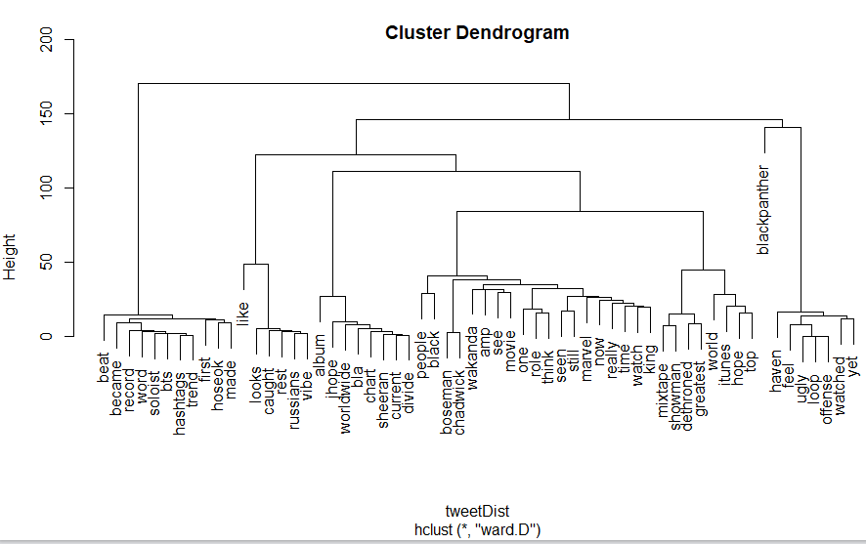

Slide 18
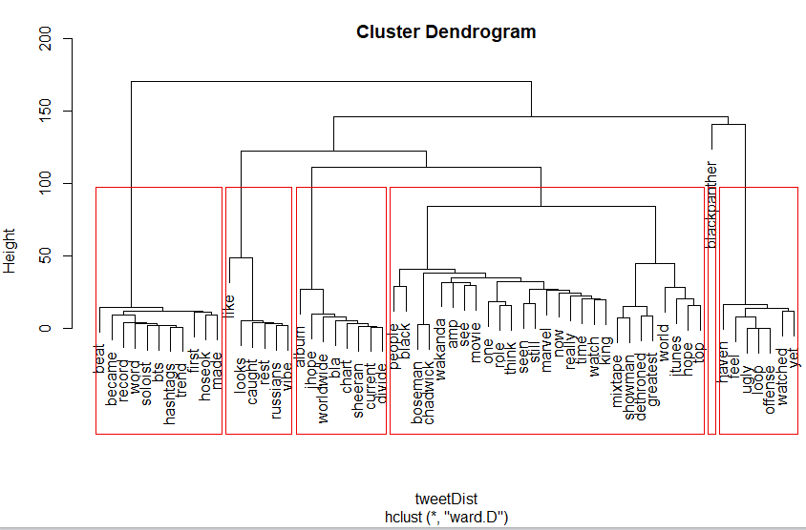

Slide 20
Topic Clusters
Topic cluster using LDA (Latent Dirichlet Allocation) algorithm
@bretmanrock?
movie soundtrack?
race?
kids’ role model?

Slide 21
Conclusions
Social media contributed to the success of Black Panther
Official accounts were involved in the conversations
“Like”, “World, “Hope” were frequently used in association with “blackpanther”
Movie soundtrack, hope and race were key parts of the conversation

